Slide 1
Institute for Quantitative & Computational Biosciences Workshop4: NGS- study design and short read mapping

Slide 2
Day 2
Mapping of short reads to a template
Different aligners (BWA, Bowtie,Bowtie2, TopHat, and STAR)
Align using parallel computing in the cluster
Mapping parameters and options
Choosing the template
Alignment
Assignment – map a readfile with different aligners on your own, compare the alignments

Slide 3
General basis of all types of NGS analysis
1. Read processing (de-multiplex, trim, filter…)
sample 1
sample 2
sample 3
2. Mapping to template
Template feature
Template feature
Template feature

Slide 4
What are the criteria for aligner performance?
Sensitivity – how often does it find a match when there is one? how often does it find the best match?
Accuracy
Speed – typically per XXX reads on a mammalian genome.
Memory requirements
GGGCCGATGCATGATGATGGA
GGGCATTCGACGATCGATCGATGCATGATGATGGA

Slide 5
What are the criteria for aligner performance?
Sensitivity – how often does it find a match when there is one? how often does it find the best match?
Accuracy
Speed – typically per XXX reads on a mammalian genome.
Memory requirements
Gapped alignments – can it handle gaps (indels)
GGGC
CGATGCATGATGATGGA
GGGCATTCGACGATCGATCGATGCATGATGATGGA

Slide 6
Aligners

Slide 7
How to choose an aligner?
Application specific:
RNAseq requires aligner that can open large gaps to map splice junctions
miRNAseq requires aligners that handle very short reads (~22bp)
DNAseq aligners should handle mismatches, repeat sequences and short indels
Also to consider
Read types:
Can the aligner handle PE and SE
What is the format required for input files? i.e. Can it handle qseq and/or FASTQ?

Slide 8
Aligner options (short list)
Aligner | Gapped alignment | SE and/or PE? | Input format | Output format | Trimming? | BS-seq | Note
BWA | Yes | SE, PE | FASTQ FASTA | SAM | No | No
Bowtie | No | SE, PE | FASTQ FASTA | SAM | Yes | No | Mismatches <=3
Bowtie2 | Yes | SE, PE | FASTQ FASTA qseq | SAM | Yes | No | Local alignment
TopHat | Yes | SE, PE | FASTQ FASTA qseq | SAM | Yes | No | Uses bowtie or bowtie2 as base aligner
STAR | Yes | SE, PE | FASTQ FASTA | SAM | Yes | No | Fastest and most accurate for RNAseq
BS-Seeker2 | Yes | SE, PE | FASTQ FASTA qseq | SAM/BAM | Yes | Yes | Uses bowtie, bowtie2, SOAP, RMAP
Notes:
Tophat is basically a specialized wrapper for bowtie2 - it manipulates your reads and aligns them with bowtie2 in order to identify novel splice junctions. It can also use given splice junctions/gene models to map your data across known splice junctions.
STAR requires at least 30 Gb to align to the human or mouse genomes.

Slide 9
Speed, Mappabaility and Memory required
Fonseca N A et al. Bioinformatics 2012;28:3169-3177
Benchmarking of different aligners:
1 million high quality reads
ref = human genome
default parameters

Slide 10
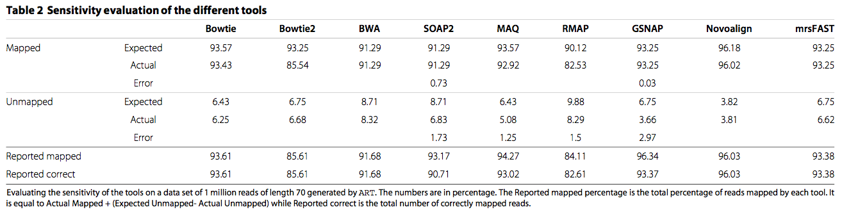
Sensitivity and Accuracy Simulated data with no errors
Hatem et al. BMC Bioinformatics 2013, 14:184

Slide 11
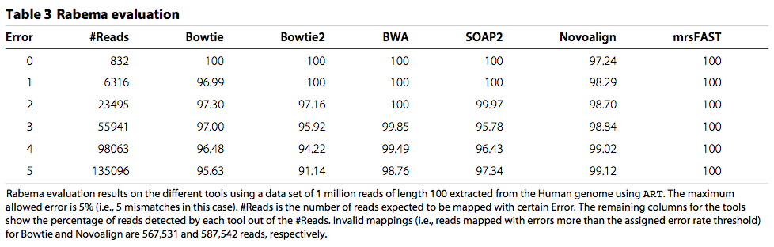
Sensitivity and Accuracy Human data with errors
Note, this will all depend on:
Reference genome used
Application
Read length
Sequencing error rate
Parameters used (ex: mismatches, gap open, soft trimming)
Hatem et al. BMC Bioinformatics 2013, 14:184

Slide 12
Reference genome aka Template, Index

Slide 13
Choosing a template ( Reference genome)
Application | Commonly used template
DNA sequencing | Genome or targeted region
RNAseq | Transcriptome and/or genome
miRNA | Precursor sequences or mature sequences
Chip / BSseq | Genome or targeted region
Choosing a template should be guided by your experiment
- what type of molecules did I assay?
- what am I looking at?
You can always map to several templates

Slide 14
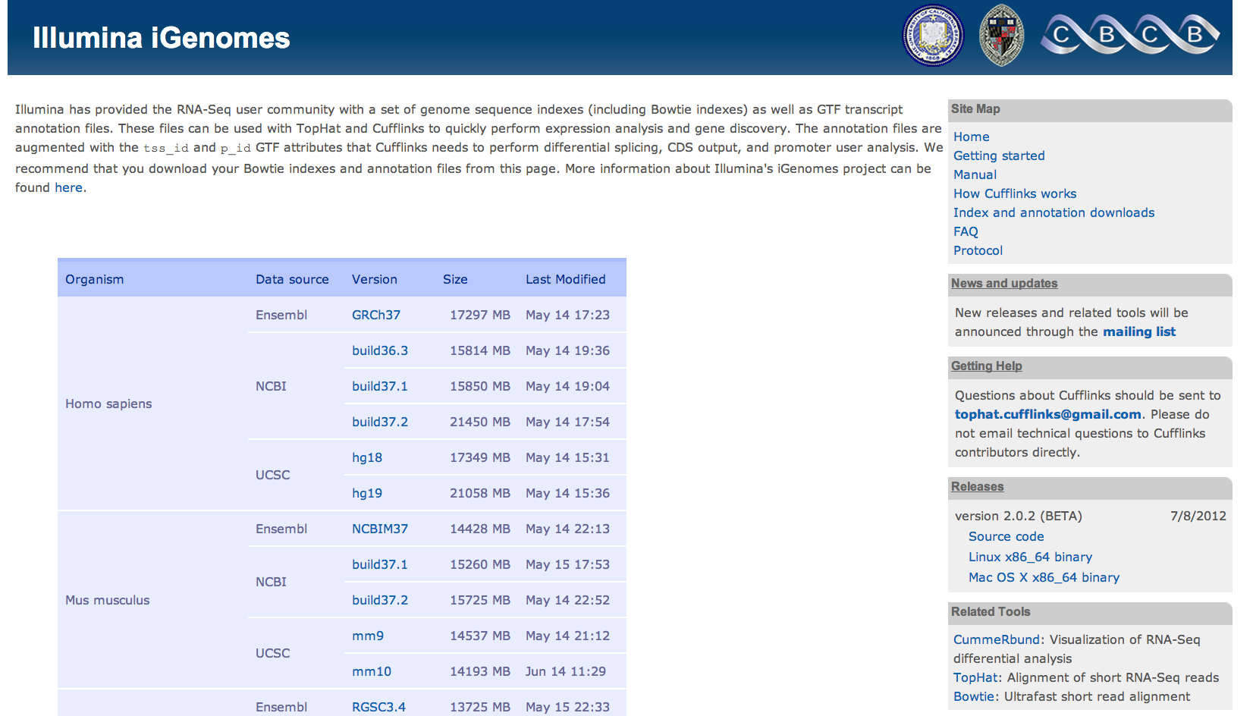
Download a Reference Genome
http://cufflinks.cbcb.umd.edu/igenomes.html

Slide 15
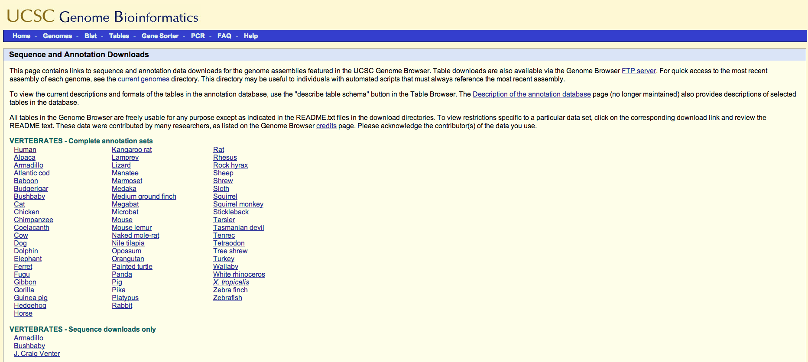
Download a Reference Genome
Download a reference genome for your organism of interest
Genomes: UCSC genome browser -> Downloads –> Genome data
http://hgdownload.soe.ucsc.edu/downloads.html

Slide 16
Alignment examples

Slide 17
Let’s do a sample alignment together Try the other aligners on your own as practice

Slide 18
Mapping on Hoffman: Log-in
Log-in to Hoffman. On terminal, type:
ssh userID@hoffman2.idre.ucla.edu
Request an interactive session:
qrsh -now n -pe shared 2 -l i,h_data=4G,h_rt=2:00:00

Slide 19
module load
Hoffman2 uses ‘module load’. You must type it into the command line before executing functions from bowtie, samtools, python,… ex:
module load bowtie
module load tophat
module load samtools
module load bwa
module load python
module load java

Slide 20
module load: modify your .bashrc file
You can also modify your ~/.bashrc file. So it does the “module load X” automatically when you request a session
less ~/.bashrc #view file
vi ~/.bashrc #open file
Type ‘i’ to insert, and type:
module load bowtie
Type ‘Esc’
Type “:wq” to save and quit

Slide 21
Mapping on Hoffman: download a genome
Use “wget” function to download directly on the command line:
wget somelink.com/file.gz
Example. Download human genome and unzip file:
wget http://hgdownload.soe.ucsc.edu/goldenPath/hg38/bigZips/hg38.fa.gz
gunzip hg38.fa.gz

Slide 22
Mapping on Hoffman – Upload your data to Hoffman
You have a few options:
Use rsync to download your data on Hoffman directly from your sequencing facility/server
- Day 1 slides
Use scp, secure copy, to copy files from your computer to Hoffman - Day 1 slides
GUI program such as Cyberduck
- In general these work ok, but crash for very large files

Slide 23
Mapping on Hoffman – indexing the reference genome
On hoffman2 make a directory for reference genome files
cd ~/scratch/Workshop4/bowtie_example/
mkdir bowtie_genome
2. Transfer the reference genome fasta file to folder “bowtie_genome”
cd ~/scratch/Workshop4/bowtie_example
cp genome.fa bowtie_genome/
3. Load aligner, and any other modules it might need
module load bowtie
4. Build index:
cd ~/scratch/Workshop4/bowtie_example/bowtie_genome/
bowtie-build genome.fa genome.fa
path to my fasta file ref genome
Base name of index for output

Slide 24
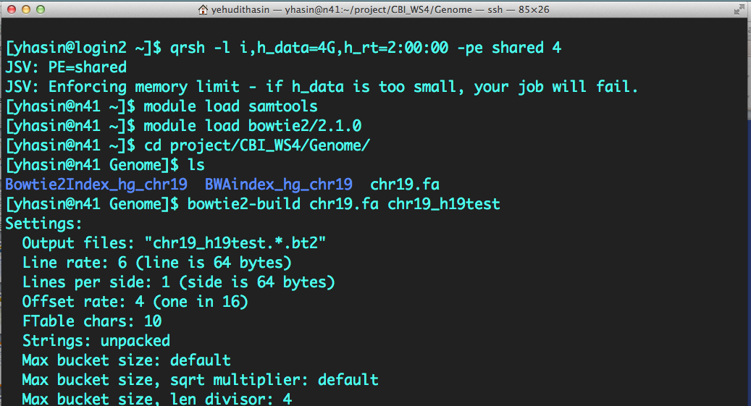
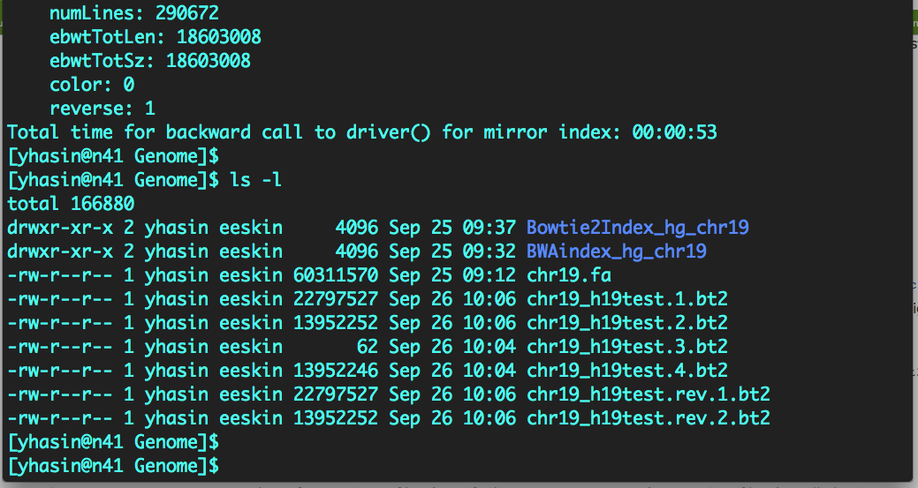
1. request computing node
2. load modules
3. go to working folder
my sequence file
4. build index
….verbose output while building index (ignore)
5. New index files
5.1 mkdir Aligner_Seq_Index
5.2 Move index files to Aligner_Seq_Index

Slide 25
Mapping on Hoffman – align your reads
1. Alignment
cd ~/scratch/Workshop4/bowtie_example/
SE
bowtie bowtie_genome/genome.fa ../data/sample_1.fastq -S sample.sam
PE
bowtie bowtie_genome/genome.fa -1 ../data/sample_1.fastq -2 ../data/sample_2.fastq -S sample.sam
- The first argument is the basename of the index for the reference genome
- The second argument is the name of the FASTQ file containing the reads
The last argument is the name of the output file where aligned reads will be written to
Options:
For paired-end reads, you must specify both files using the options -1 and -2, ex: -1 file1 -2 file2
-S name of output file, in SAM format

Slide 26
Mapping on Hoffman – align examples
bowtie -m 1 bowtie_genome/genome.fa -1 ../data/sample_1.fastq -2 ../data/sample_2.fastq -S sample.sam
bowtie -5 5 bowtie_genome/genome.fa -1 ../data/sample_1.fastq -2 ../data/sample_2.fastq -S sample.sam
bowtie -3 5 bowtie_genome/genome.fa -1 ../data/sample_1.fastq -2 ../data/sample_2.fastq -S sample.sam
bowtie -v 3 bowtie_genome/genome.fa -1 ../data/sample_1.fastq -2 ../data/sample_2.fastq -S sample.sam
Options/Parameters:
-m 1 report alignments with no more than 1 alignment.
ie. report only uniquely aligned reads
-5 5 trim the first 5 bases
-3 5 trim the last 5 bases
-v 3 allow no more than 3 mismatches

Slide 27
Homework

Slide 28
Try the other aligners on your own The code on the slides works, and I gave you sample input/output files for each aligner: bwa, bowtie/bowtie2, tophat, STAR Look at the manuals, modify parameters on your own and see how it affects your alignment

Slide 29
Mapping on Hoffman – BWA (DNA aligner)
Manual at: http://bio-bwa.sourceforge.net/bwa.shtml
1. Module load and go to correct direction
module load bwa
cd ~/scratch/Workshop4/bwa_example
2. Index the reference genome
bwa index bwa_genome/genome.fa
3. Align each file (single or paired end) , ex:
bwa aln bwa_genome/genome.fa ../data/sample_1.fastq > sample_1.sai
4. Convert .sai file to .sam (for paired end combine the 2 .sai files into one SAM)
SE:
bwa samse bwa_genome/genome.fa sample_1.sai ../data/sample_1.fastq > sample.sam
PE:
bwa sampe bwa_genome/genome.fa sample_1.sai sample_2.sai ../data/sample_1.fastq ../data/sample_2.fastq >sample.sam
Notes:
Uses a Burrows-Wheeler transform to create an index of the genome. It's a bit slower than bowtie but allows indels in alignment
- SE and PE reads
Uses quality scores.
Supports older versions of Illumina quality scores: -I The input is in the Illumina 1.3+ read format (quality equals ASCII-64).
Gapped alignment
Multithreading
Trims reads using the -q option

Slide 30
Mapping on Hoffman – Bowtie2 (good for RNAseq)
Manual at: http://bowtie-bio.sourceforge.net/bowtie2/manual.shtml
1. Module load and go to Bowtie2 directory
module load bowtie2
cd ~/scratch/Workshop4/bowtie2_example
2. Index the reference genome
bowtie2-build bowtie2_genome/genome.fa bowtie2_genome/genome.fa
3. Align each sample. Different for single or paired end:
SE:
bowtie2 -x bowtie2_genome/genome.fa -U ../data/sample_1.fastq -S sample.sam
PE:
bowtie2 -x bowtie2_genome/genome.fa -1 ../data/sample_1.fastq -2 ../data/sample_2.fastq -S sample.sam
Notes:
Main arguments:
-x The basename of the index for the reference genome.
-U Comma-separated list of files containing unpaired reads to be aligned, e.g. lane1.fq,lane2.fq,lane3.fq,lane4.fq.
-S File to write SAM alignments to.
-1 Comma-separated list of files containing mate 1s (filename usually includes _1), e.g. -1 flyA_1.fq,flyB_1.fq. Sequences specified with this option must correspond file-for-file and read-for-read with those specified with the “-2” option
-2 Comma-separated list of files containing mate 2s (filename usually includes _2), e.g. -2 flyA_2.fq,flyB_2.fq. Sequences specified with this option must correspond file-for-file and read-for-read with those specified in the “-1” option
--qseq --qc-filter filter reads QC, i.e. PF filter=0
only supported in bowtie2
* Uses a Burrows-Wheeler transform to create a permanent, reusable index of the genome; 1.3 GB memory footprint for human genome. Aligns more than 25 million Illumina reads in 1 CPU hour.
* SE and PE alignment
Gapped alignment
* Trimming with the -5 and -3 options
* Supports Phred+33 and Phred+64 (older illumina scores) quality scores with the --phred33 and --phred64 options
* Supports FASTQ, qseq and FASTA input file formats
The chief differences between Bowtie 1 and Bowtie 2 are:
For reads longer than about 50 bp Bowtie 2 is generally faster, more sensitive, and uses less memory than Bowtie 1. For relatively short reads (e.g. less than 50 bp) Bowtie 1 is sometimes faster and/or more sensitive.
Bowtie 2 supports gapped alignment with affine gap penalties. Number of gaps and gap lengths are not restricted, except by way of the configurable scoring scheme. Bowtie 1 finds just ungapped alignments.
Bowtie 2 supports local alignment, which doesn't require reads to align end-to-end. Local alignments might be "trimmed" ("soft clipped") at one or both extremes in a way that optimizes alignment score. Bowtie 2 also supports end-to-end alignment which, like Bowtie 1, requires that the read align entirely.
There is no upper limit on read length in Bowtie 2. Bowtie 1 had an upper limit of around 1000 bp.
Bowtie 2 allows alignments to overlap ambiguous characters (e.g. Ns) in the reference. Bowtie 1 does not.
Bowtie 2 does away with Bowtie 1's notion of alignment "stratum", and its distinction between "Maq-like" and "end-to-end" modes. In Bowtie 2 all alignments lie along a continuous spectrum of alignment scores where the scoring scheme, similar to Needleman-Wunsch and Smith-Waterman.
Bowtie 2's paired-end alignment is more flexible. E.g. for pairs that do not align in a paired fashion, Bowtie 2 attempts to find unpaired alignments for each mate.
Bowtie 2 reports a spectrum of mapping qualities, in contrast fo Bowtie 1 which reports either 0 or high.
Bowtie 2 does not align colorspace reads.

Slide 31
Mapping on Hoffman – TopHat (for RNAseq)
Manual at: http://ccb.jhu.edu/software/tophat/manual.shtml
1. Module load and go to directory
cd ~/scratch/Workshop4/tophat_example/
module load bowtie2
module load tophat
2. Index the reference genome
bowtie2-build tophat_genome/genome.fa tophat_genome/genome
3. Align each sample. For single or paired end:
SE:
tophat -N 2 -p 2 tophat_genome/genome ../data/sample_1.fastq
PE:
tophat -N 2 -p 2 tophat_genome/genome ../data/sample_1.fastq ../data/sample_2.fastq
Notes:
forward reads file name
reverse reads file name
Note: If you have multiple fastq files, these should listed together, separated by commas
-N Xinteger = max # of mismatches
-p <int> Use this many threads to align reads. The default is 1.
-o <string> Sets the name of the directory in which TopHat will write all of its output. The default is "./tophat_out".
TopHat is a program that aligns RNA-Seq reads to a genome in order to identify exon-exon splice junctions. It is built on Bowtie.
Default parameters are fine-tuned for alignment to a mammalian genome
The software is optimized for reads 75bp or longer
Can use bowtie or bowtie2 as its alignment algorithm
Multithreading
FASTQ,FASTA,qseq file formats
SE and PE reads
Supports older versions of Illumina quality scores

Slide 32

Mapping PE reads
Paired end reads carry a different type of information, additional to that of SE.
They allow an estimation of a true distance between two reads and compare it to the distance indicated in the template.
PE = paired end
(mate pairs)
deletion
distance on template is larger than library size
insertion
distance on template is smaller than library size
200bp
200bp
500bp
50bp

Slide 33
PE reads for RNAseq
In RNAseq paired end reads facilitate identification of new splice junctions, as they carry information about particular physical arrangement of exons, even though neither of the reads may span the junction by itself.
Ex1
Ex2
Ex3
1
2
3
1
3
This comes at the expense of coverage, since the second end does not represent an independent sampling of the pool.

Slide 34
Mapping PE – how does TopHat work?
1. Align reads with Bowtie
+
2. Re-align reads that don’t map with Bowtie, splitting them into up to 3 fragments
3. Use distances (if PE) and split reads to identify junctions, use clusters of reads to identify junction border
4. Output – four files:
accepted hits.BAM,
junctions,
insertions and deletions.
Notes:
accepted_hits.bam. A list of read alignments in SAM format. SAM is a compact short read alignment format that is increasingly being adopted.
junctions.bed. A UCSC BED track of junctions reported by TopHat. Each junction consists of two connected BED blocks, where each block is as long as the maximal overhang of any read spanning the junction. The score is the number of alignments spanning the junction.
insertions.bed and deletions.bed. UCSC BED tracks of insertions and deletions reported by TopHat.
Insertions.bed - chromLeft refers to the last genomic base before the insertion.
Deletions.bed - chromLeft refers to the first genomic base of the deletion.

Slide 35
TopHat –estimation of inner size
library=250bp
adaptors=60
reads=50+50=100
inner distance = 250-60-100=90bp

Slide 36
Mapping on Hoffman – STAR
Manual : http://code.google.com/p/rna-star/downloads/detail?name=STARmanual_2.3.0.1.pdf&can=2&q=
1. Go to STAR directory. It is not installed on Hoffman so we will use a local installation
cd ~/scratch/Workshop4/STAR_example/
2. Index the reference genome
./STAR_bin/STAR --runMode genomeGenerate --genomeDir ./star_genome/ --genomeFastaFiles ./star_genome/genome.fa --runThreadN 2
3. Align each sample. Note, make a new directory for output, here called “/output_dir/”
SE:
cd ~/scratch/Workshop4/STAR_example/output_dir/
../STAR_bin/STAR --genomeDir ../star_genome --readFilesIn ../../data/sample_1.fastq
PE:
../STAR_bin/STAR --genomeDir ../star_genome --readFilesIn ../../data/sample_1.fastq ../../data/sample_2.fastq

Slide 37
Align sequencing files by submitting jobs in parallel to the cluster
Let’s do an example together

Slide 38
Submit alignment jobs in parallel using bowtie
Files required. All in the same directory:
1. Sequencing data file (FASTQ for bowtie)
Ex: sample_1.fastq or LaneX.fastq
2. An indexed genome folder and file
Ex: The bowtie_genome/ folder you created today
3. The scripts:
1_align_in_batch.sh
align.sh
wrapper_align.sh

Slide 39
Submit the jobs using the command
Go to the directory with the files and scripts:
cd ~/scratch/Workshop4/batch_jobs/
Load programs needed. In this example, bowtie:
module load bowtie
module load samtools
Submit the jobs.
Usage: $./script.sh MySeqFile.fastq
./1_align_in_batch.sh sample_1.fastq

Slide 40
Check status of your jobs
Command to check status
qstat -u userID
You will see a list of your jobs. When waiting, or on “queue”, your jobs will say qw. When they start running they will say r. When they are done they will disappear from the queue

Slide 41
Merge all output bam files into one
Once alignment is finished. Merge all bam files into one. Since the script splits your sample seq file into smaller seq files, you will get a SAM and BAM file for each split file.
To merge them again, use samtools:
module load samtools
cd ~/scratch/Workshop4/batch_jobs/seq/
samtools merge SampleX.bam *.bam

Slide 42
Homework
Modify the script for other aligners and try it on your own

